Slide 1
Thread synchronization
Wait / Notify / NotifyAll methods in Java By Petar Georgiev

Slide 2
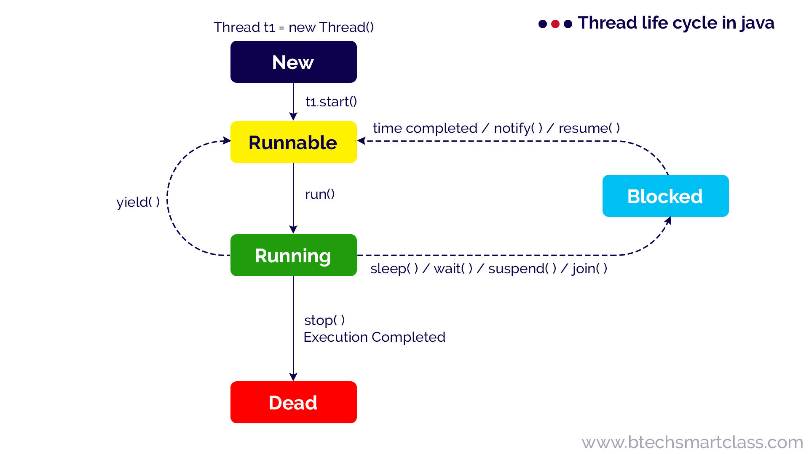
Thread lifecycle

Slide 3
Introduction
Java provides wait(), notify() and notifyAll() methods to enable threads to communicate and cooperate with each other in a synchronized environment.
These methods are defined in the Object class and can be used by any class that needs to synchronize access to shared resources.

Slide 4
The wait() method
The wait() method causes the current thread to release the lock on the object it is synchronized on and wait for another thread to notify it.
While waiting, the thread is in a waiting state and does not consume CPU resources.
The method can take an optional timeout parameter, after which the thread will automatically resume execution.

Slide 5
The notify() method
The notify() method wakes up a single thread that is waiting on the object it is synchronized on.
If multiple threads are waiting, the method will wake up one of them, but it is not specified which one.

Slide 6
The notifyAll() method
The notifyAll() method wakes up all threads waiting on the object it is synchronized on.

Slide 7
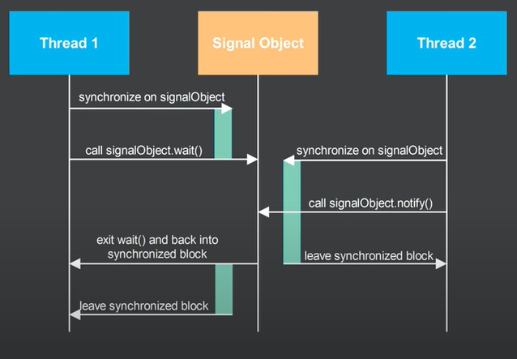
Sequence diagram

Slide 8
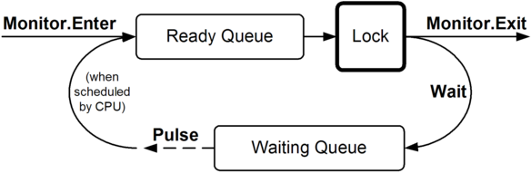

Slide 9
Proper use
The wait(), notify() and notifyAll() methods should always be used inside a synchronized block to ensure that the thread holds the lock on the object it is waiting or notifying on.
If a thread calls wait() or notify() outside of a synchronized block, an IllegalMonitorStateException will be thrown.

Slide 10
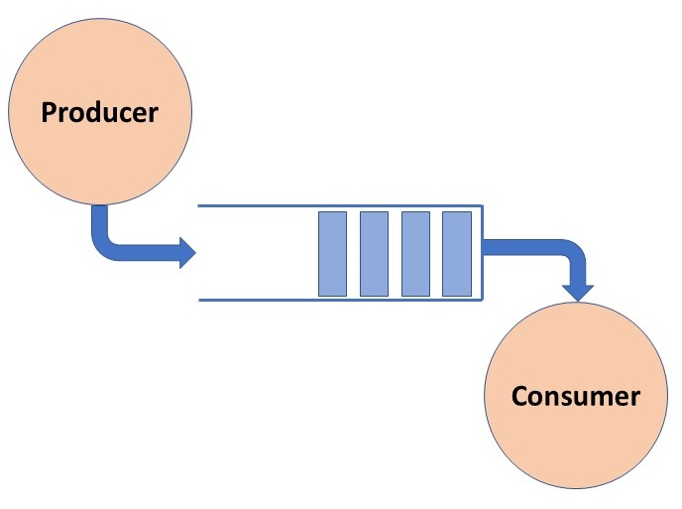
Producer / Consumer problem

Slide 11
Producer-consumer scenario
wait() and notify() methods are often used in a producer-consumer scenario, where one or more producer threads generate data and put it into a shared buffer, while one or more consumer threads read the data from the buffer.
The buffer is protected by a lock that the producers and consumers acquire before accessing the buffer.
Producers call wait() when the buffer is full, and consumers call wait() when the buffer is empty.
When a producer adds an item to the buffer, it calls notifyAll() to wake up all waiting consumers, and when a consumer removes an item from the buffer, it calls notifyAll() to wake up all waiting producers.

Slide 12
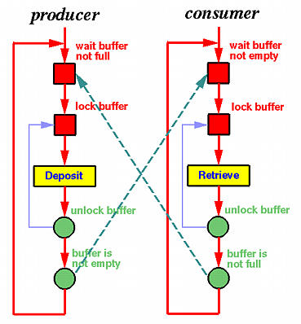
Producer / Consumer problem

Slide 13
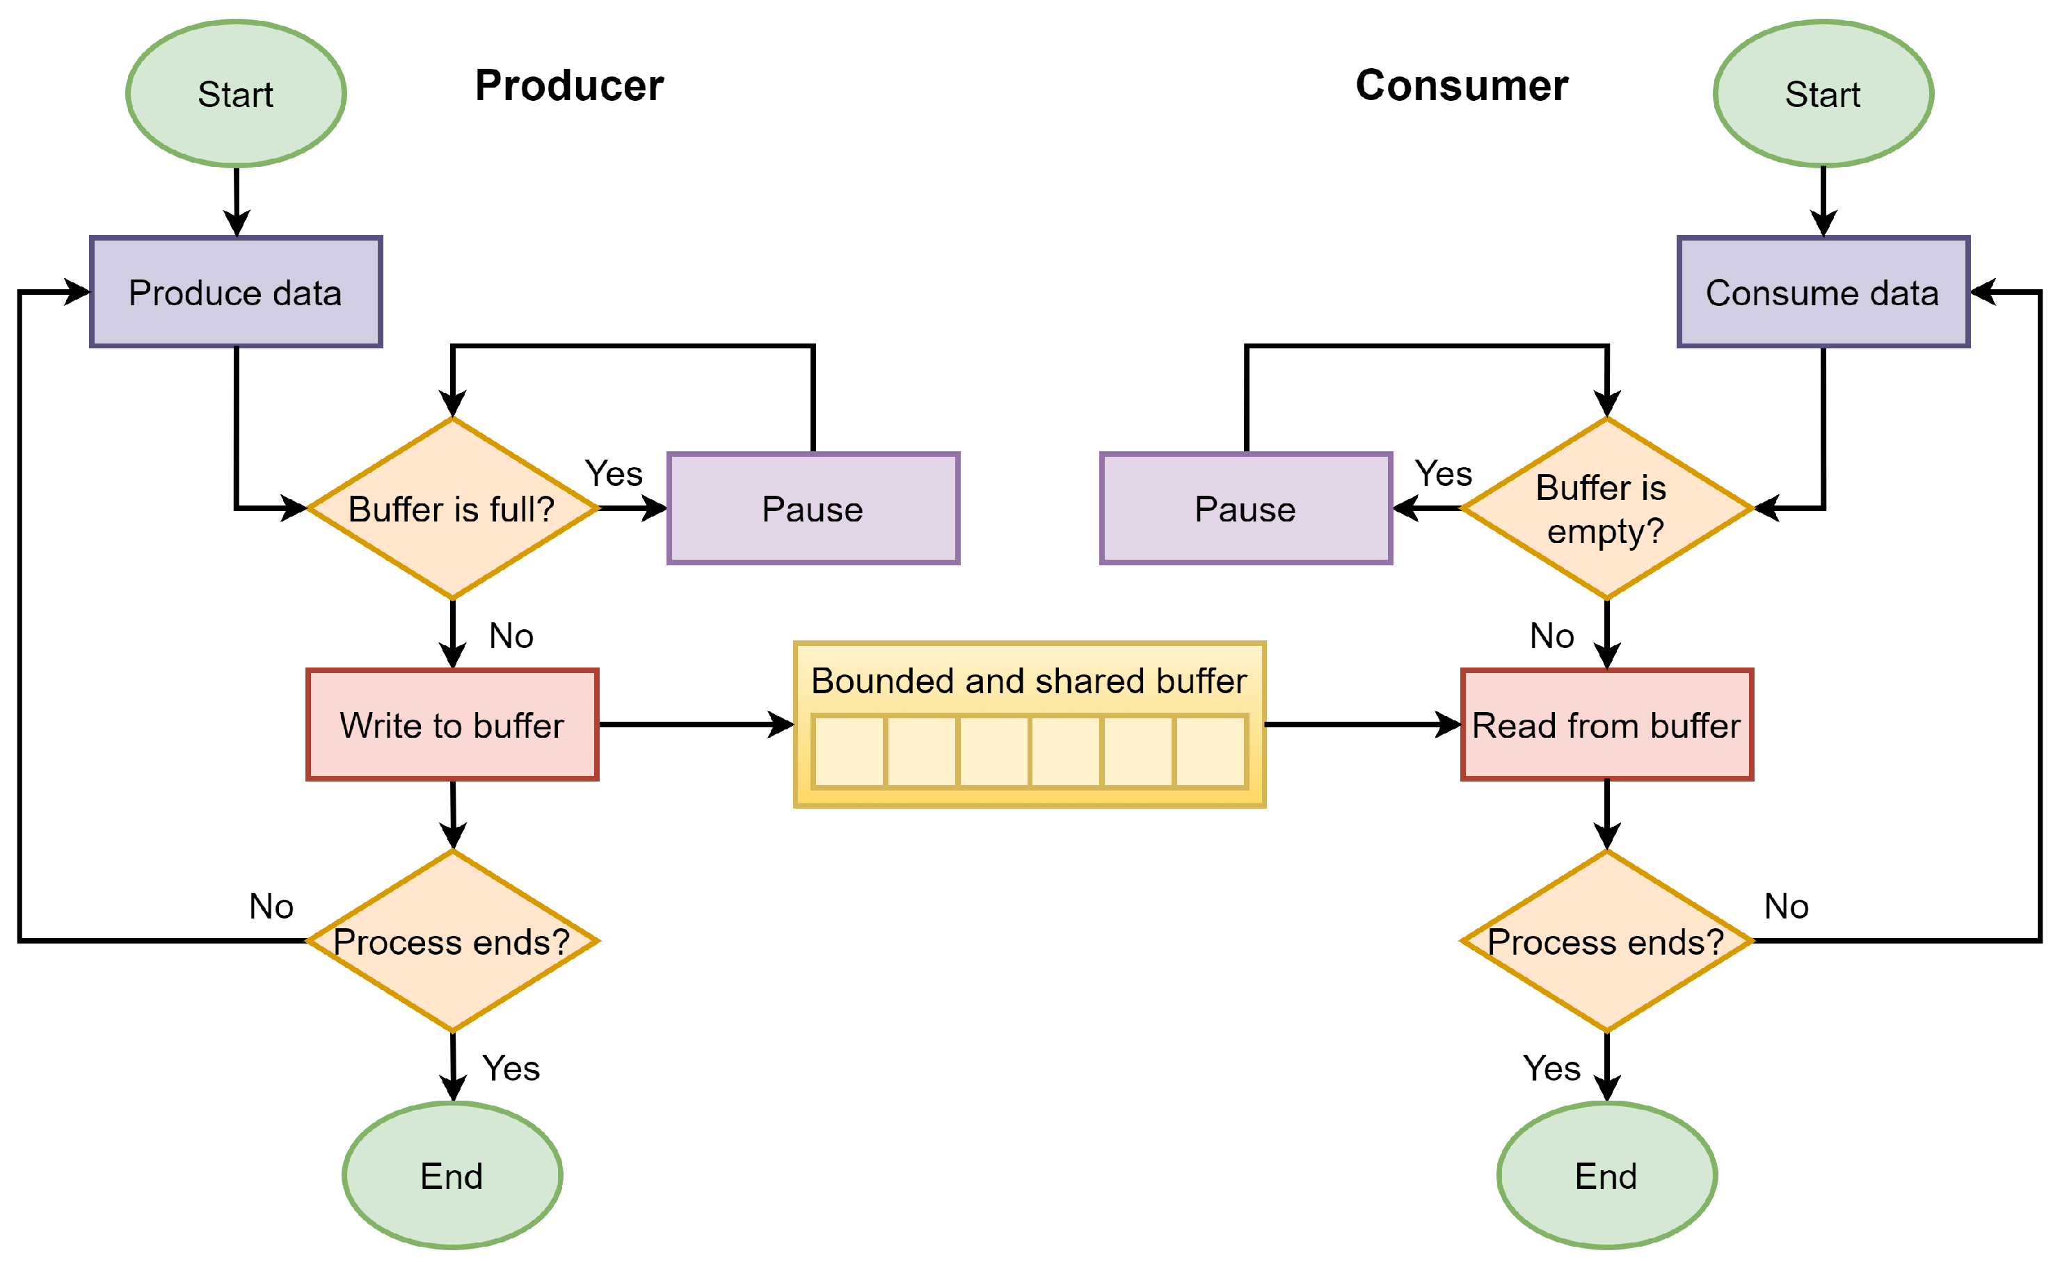
Producer / Consumer problem

Slide 14
Conclusion
wait() and notify() methods are an important tool for managing concurrent access to shared resources in Java.
Proper use of these methods can help to avoid race conditions and deadlocks, and can ensure that threads cooperate and avoid conflicts over shared resources.

